Slide 1
16
Discrete Mathematics
Rules of Inference for Quantified Statements

Slide 2


















Slide 3

























Slide 4













Slide 5














Slide 6
























Slide 7
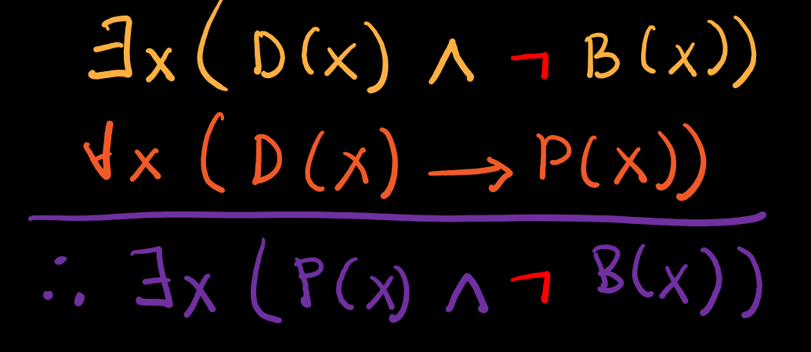

Slide 8
Up Next…
Methods of Proof:
Direct Proof

